Slide 1
Exploring and Troubleshooting Your Builds
Warren Frame

Slide 2


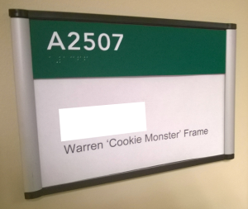


About Me
What do I do?
Infrastructure Engineer, FAS Research Computing, Harvard University
Design and build solutions, learn, share
Other interests:
science, infosec
tech, cooking
tennis, family
Where to find me
Twitter.com/PSCookieMonster
LinkedIn.com/in/wframe
RamblingCookieMonster.github.io
Github.com/RamblingCookieMonster
PowerShell Slack Community
Notes:
Microsoft, VMware, Citrix, etc.
I'm on LinkedIn and Twitter, feel free to connect
slack.poshcode.org > submit your e-mail, join up!

Slide 3
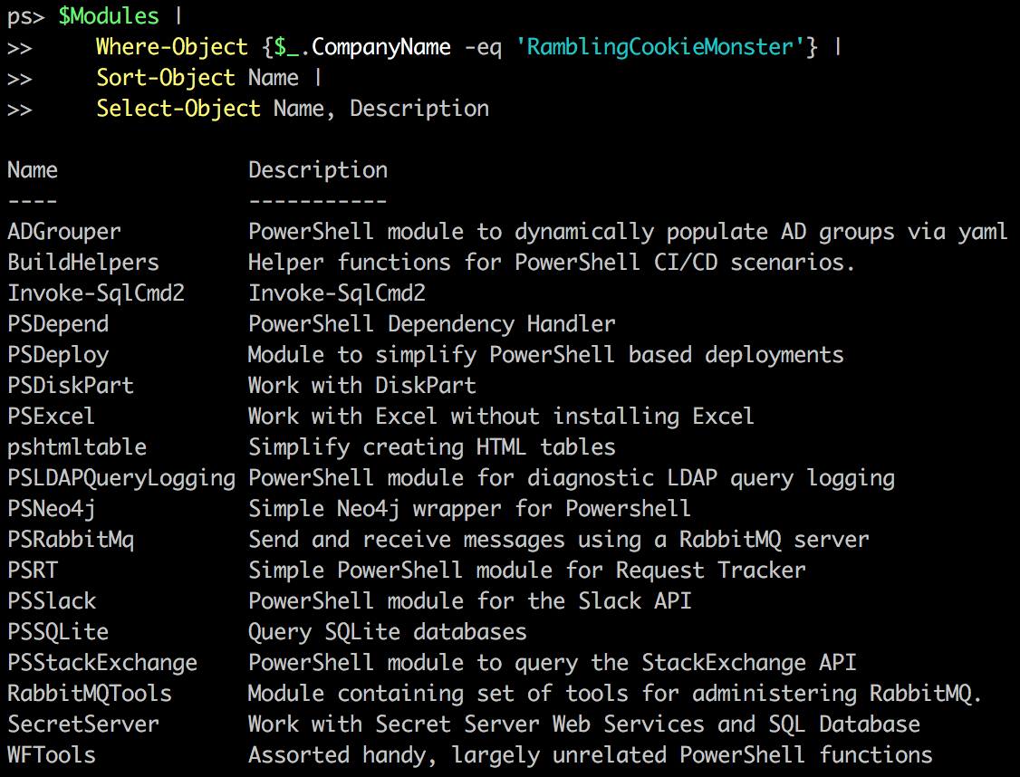
About Me
Notes:
BuildHelpers
PSDeploy
PSDepend
PSSlack

Slide 4


Slide 5
Where Does This Apply?
To pretty much anything that doesn’t run interactively

Slide 6

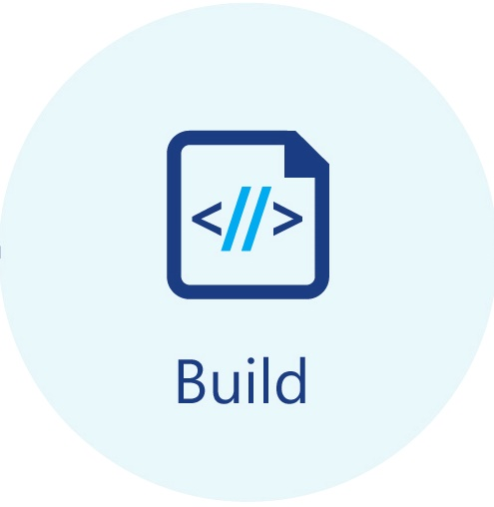

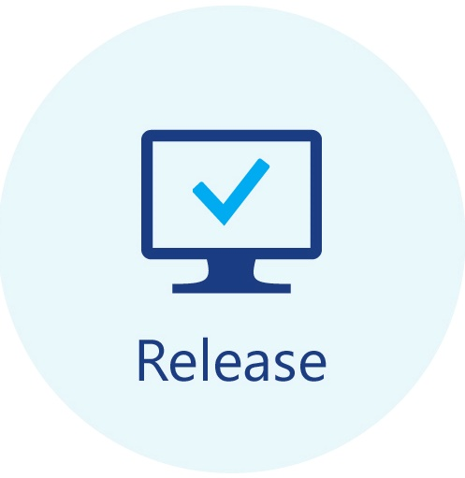










Build Systems – CI, CD, Release Pipelines, etc.

Slide 7
Scheduled Tasks, Runbooks, etc.

Slide 8
Scripts-As-A-Service
Jenkins
WebCommander
PoshBot
FAAS - Azure Functions, etc.
Notes:
Jenkins:
https://hodgkins.io/automating-with-jenkins-and-powershell-on-windows-part-1
https://hodgkins.io/automating-with-jenkins-and-powershell-on-windows-part-2
PoshBot:
https://github.com/poshbotio/PoshBot
http://ramblingcookiemonster.github.io/PoshBot/
WebCommander:
https://github.com/vmware/webcommander
Azure Functions:
https://blogs.msdn.microsoft.com/powershell/2017/02/24/using-powershell-modules-in-azure-functions/
https://blogs.msdn.microsoft.com/mvpawardprogram/2017/08/15/serverless-azure-functions/
https://www.youtube.com/watch?v=_NZuuQ5rUJM

Slide 9
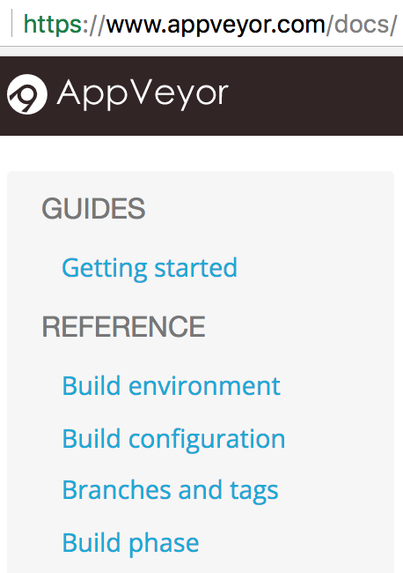
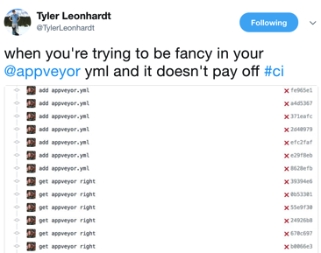

Exploring and Troubleshooting
Read
Experiment
Assumed: Ask questions
Notes:
https://www.appveyor.com/docs/
https://docs.gitlab.com/ce/ci/README.html

Slide 10
Experimenting
Problem: These aren’t interactive!
Potential solution:
Run your query, figure out what to do with the output:
Write it out
Bundle up output and put it somewhere accessible
Send it to another system
Interact(ish)

Slide 11
Examples and Demos
Notes:
GitLab CE CI
AppVeyor

Slide 12
Questions?

Slide 13
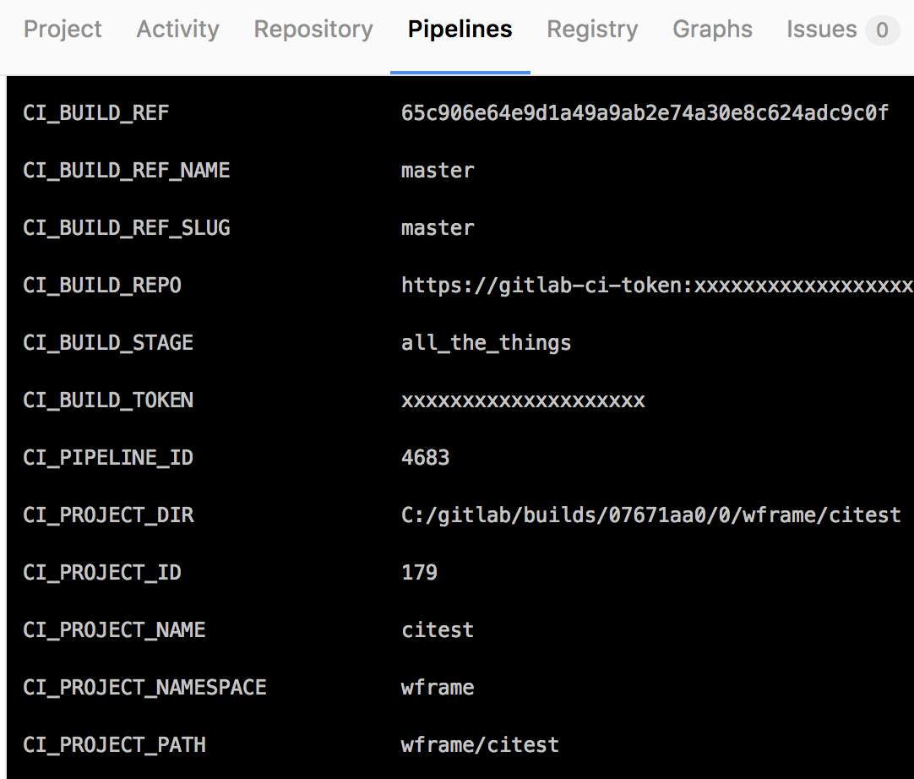
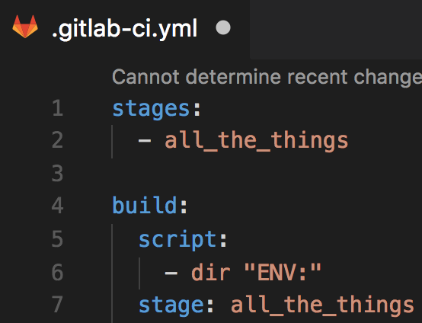
What Variables are Available? Experimenting
Notes:
I tend to read first, experiment second, but all depends!
A look at writing things to output. GitLab isn’t quite as nice with colors or formatting in their build logs
This works, but depending on what you want to collect, it doesn’t scale:
https://ci.appveyor.com/project/RamblingCookieMonster/zappveyor-explore

Slide 14
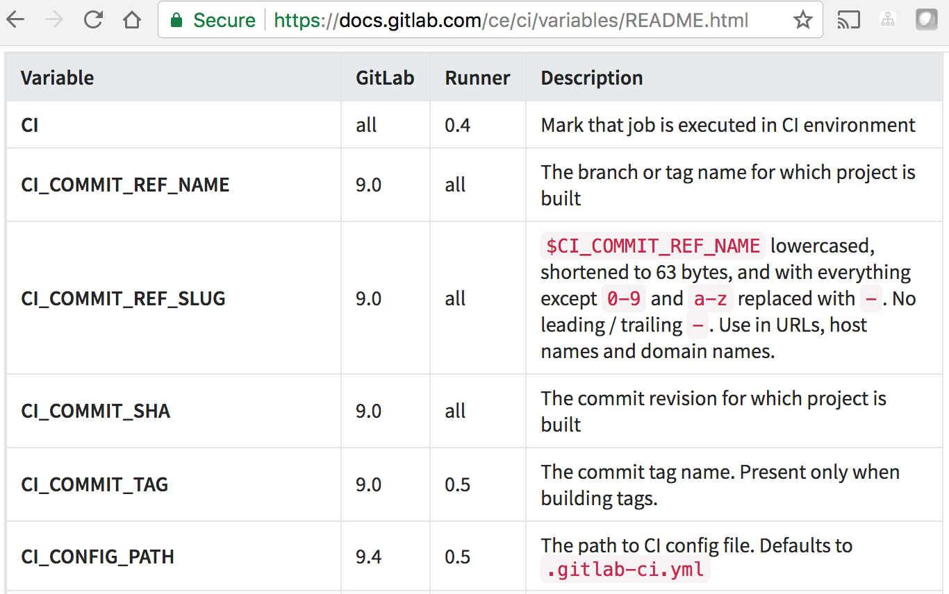
What Variables are Available? Reading
Wait… What do those values actually mean? Read the docs!
Notes:
https://docs.gitlab.com/ce/ci/variables/README.html
https://www.appveyor.com/docs/environment-variables
https://github.com/RamblingCookieMonster/BuildHelpers
Gathers from:
AppVeyor
GitLab CI
Jenkins
Teamcity
VSTS
Bamboo
GoCD
Travis CI

Slide 15
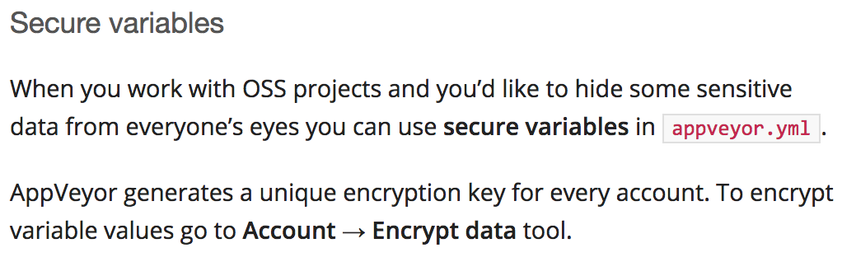
How Do I Store a Secret? Reading
In source control
Read the docs!
Other options
Serialized on build node. Problem: Tightly coupled to node. potential risk.
Actual secret management*. Problem: You might not have this.
* Not KeyPass or anything like it. Audit, authentication, etc. are important
Notes:
https://www.appveyor.com/docs/build-configuration/#secure-variables
https://docs.gitlab.com/ce/ci/variables/README.html#secret-variables
Vault, Secret Server, etc.

Slide 16
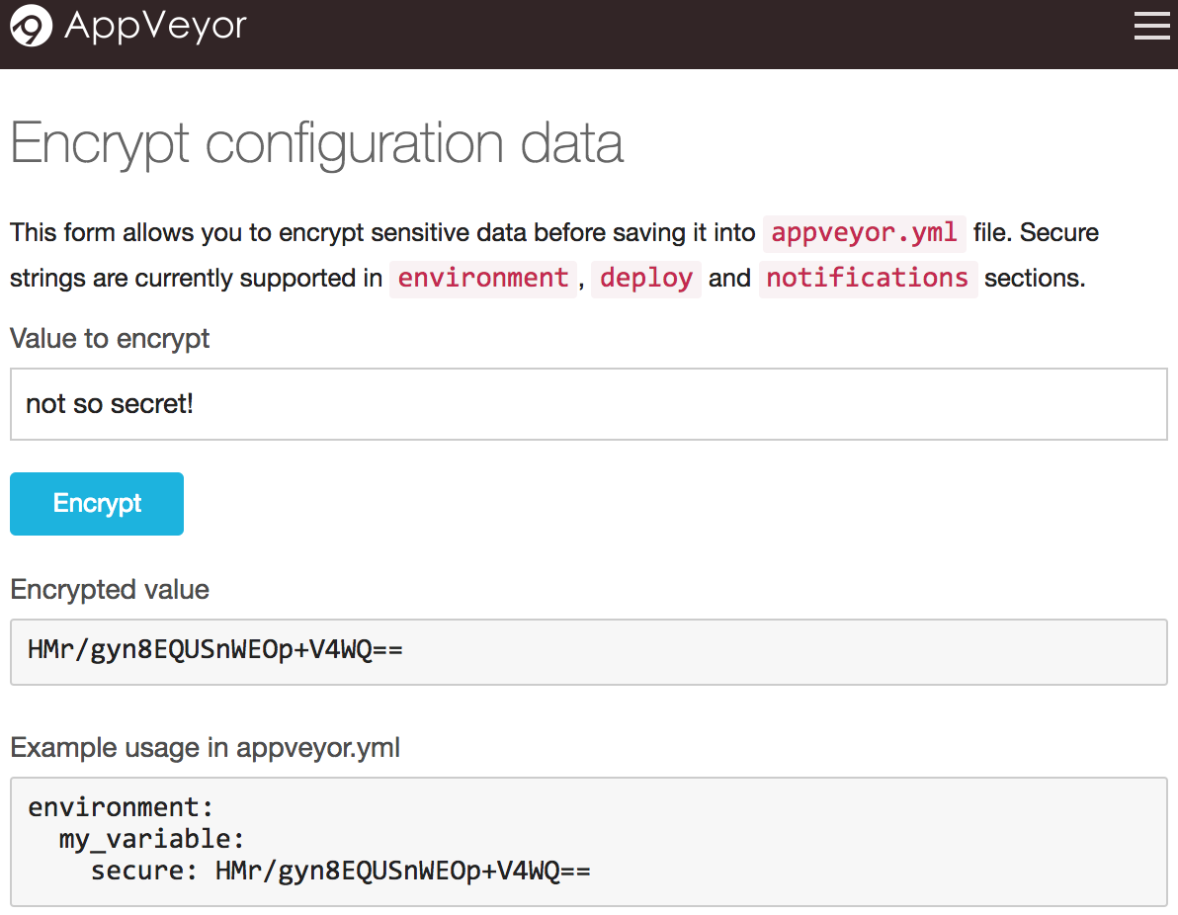
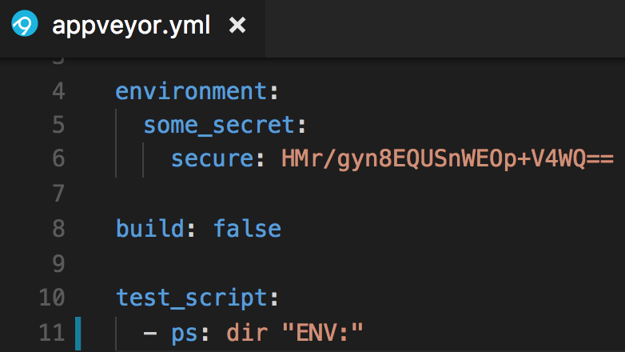
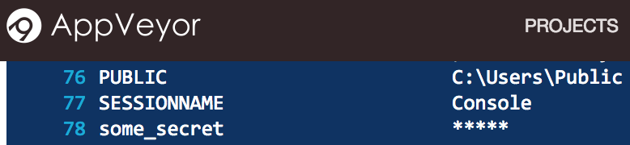
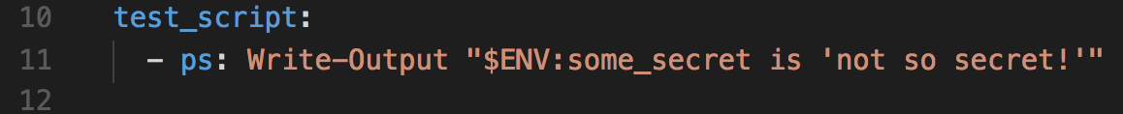
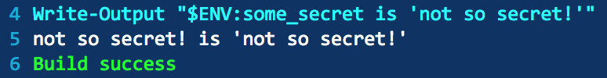
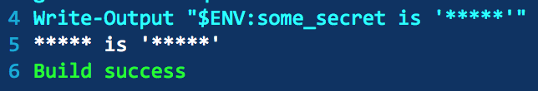
How Do I Store a Secret? Experimenting
Notes:
TIL! You’ll see the secret while the build is in progress. Once complete, any secret variable values found in the log are sanitized. Pretty cool
https://help.appveyor.com/discussions/problems/9079-appveyor-secure-var-docker-login-doesnt-work

Slide 17
Questions?

Slide 18
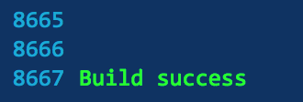
Who wants to scroll through build logs?
Serialize, place somewhere accessible, rehydrate in PowerShell!
Send important bits to chat or other systems

Slide 19
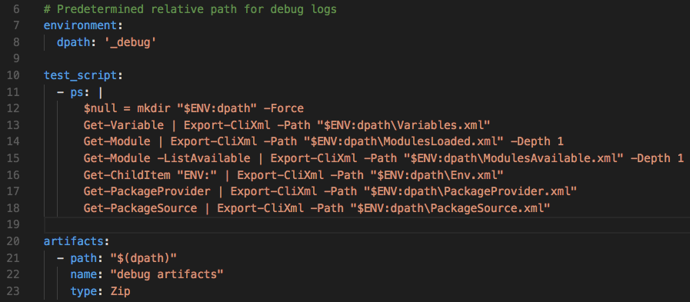
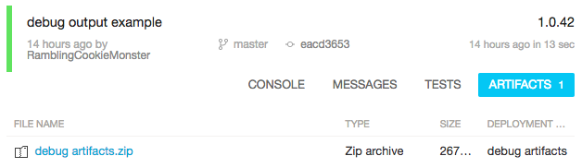
Debug Artifacts
Notes:
https://www.appveyor.com/docs/packaging-artifacts/
https://docs.gitlab.com/ce/user/project/pipelines/job_artifacts.html

Slide 20
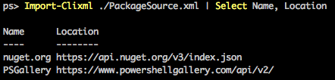
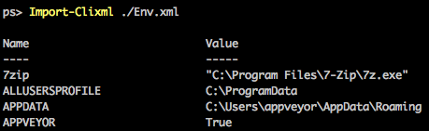
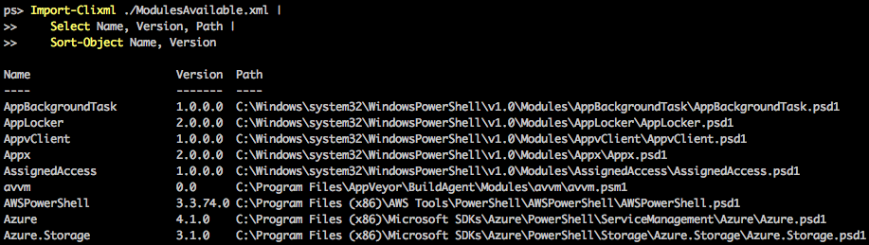
Debug artifacts

Slide 21
Questions?

Slide 22
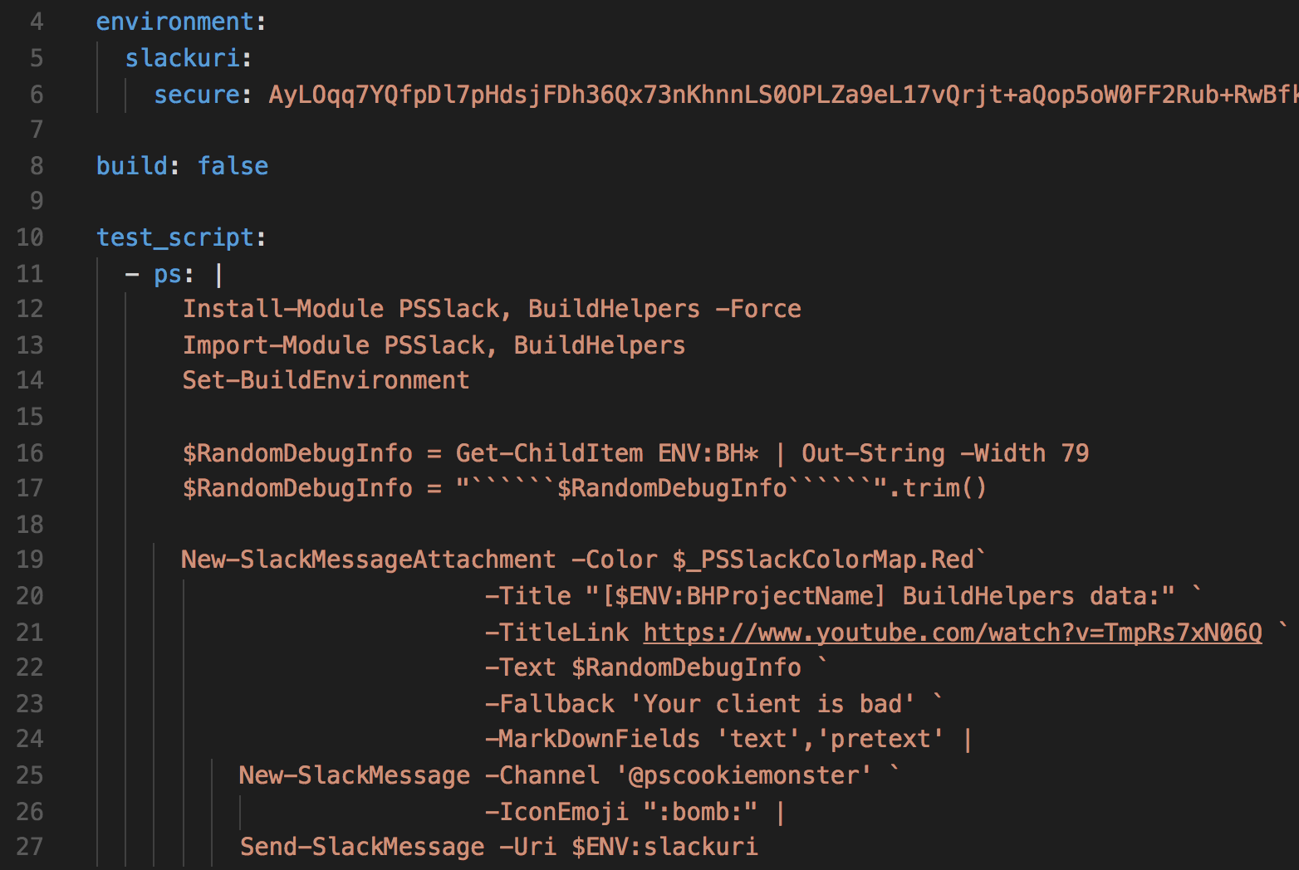
Notifications
Notes:
https://www.appveyor.com/docs/notifications/#slack
https://www.appveyor.com/docs/notifications/#webhook-payload-default (data you can include in template)
https://docs.gitlab.com/ce/user/project/integrations/slack.html

Slide 23
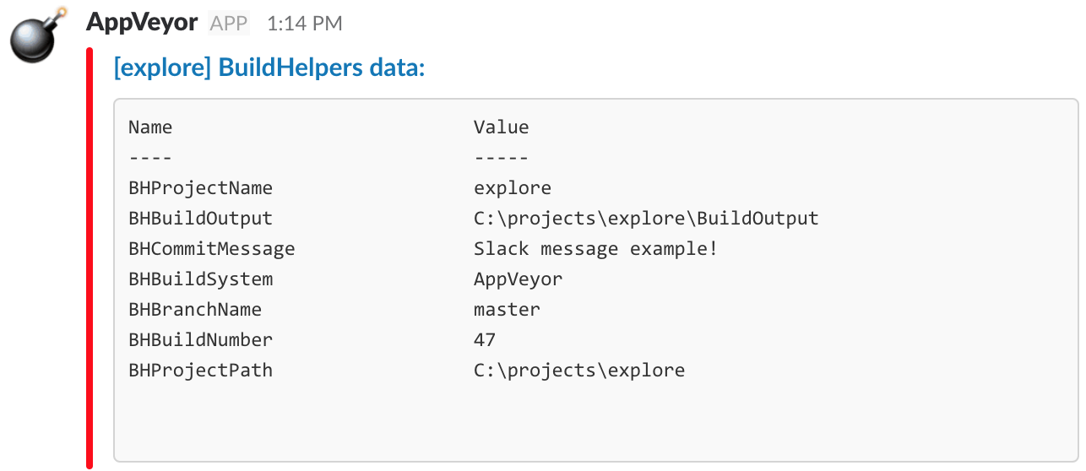
Notifications

Slide 24
Interact(ish)
Some CI services support this
You can build it into your internal CI system
Notes:
https://www.appveyor.com/docs/how-to/rdp-to-build-worker/
https://help.appveyor.com/discussions/problems/5961-cant-rdp-to-build-agent
https://help.appveyor.com/discussions/problems/9599-rdp-invalid-login-credentials

Slide 25
Common Issues
Build node changed!
New OS?
New software?
New modules?
Dependency management fun
Install-Module Pester...
New use cases or needs
Designing / adjusting a build

Slide 26


Questions?

